Slide 1

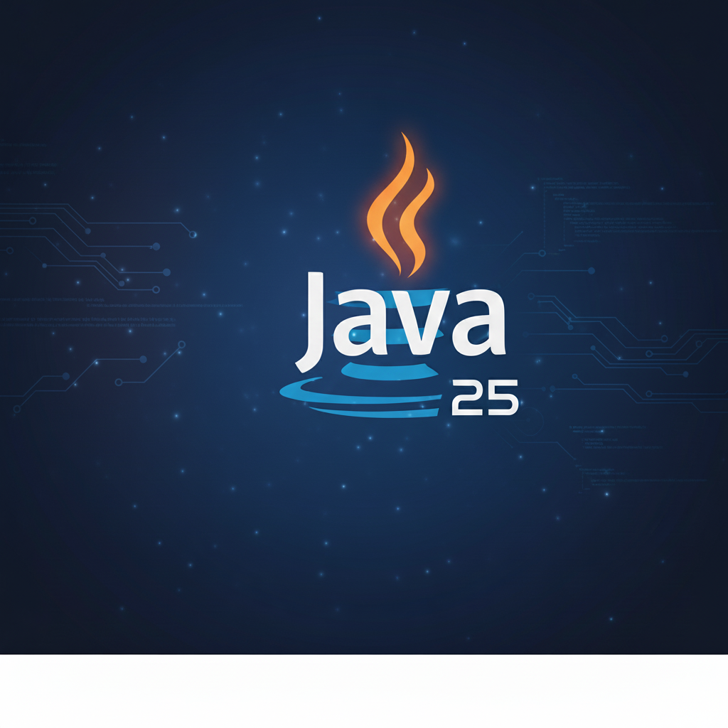

JAVA 25 – NEW FEATURES
Notes:
Hello folks, my name is Leandro Iglezias and today I will talk about Java twenty five. More specifically the new features. Let´s get start

Slide 2

AGENDA
Java LTS Versions
New Features
Demos
Notes:
Here is our agenda for this lunch and learn, we will start to explain what is LTS version, and after that we will enter in new features of Java twenty five (25), will see each one these new features and try to compare with last LTS version, which is Java 21

Slide 3
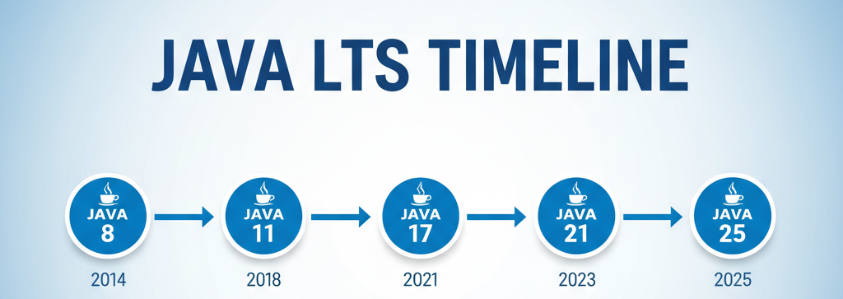
LTS Versions
LTS means Long-Term support.
Updates and support to for a long period about 3 Years
LTS Versions are Java 8, Java 11, Java 17, Java 21 and now Java 25
It is a trend to reduce this time space between LTS launches. How we can see
Notes:
LTS means Lont-Term support. So what?
Well in other words, this version will receive updates and support to performance improvement and security fixes
Long period? But How long?
This long period, according to the Oracle website is 1 year after the release of the new LTS version, currently around 3 years. After that the support and updates exist only for commercial subscribers
So The latest LTS versions are Java eight, Java eleven, Java seventeen, Java twenty one and Java twenty five.
It is as trend to reduce this time space between LTS Launchs. Like we can seen in this timeline, From java Eight to Java Eleven takes four years, from eleven to seventeen takes three years, seventeen to twenty one, two years and twenty one to twenty five two years again.
By now Oracle trend to maintain this often of LTS launches.

Slide 4
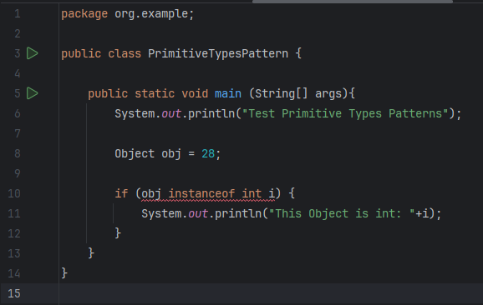
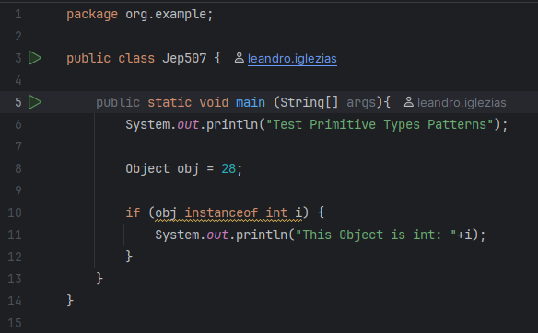
Java 25 new Features
Primitive Types in Patterns (JEP 507 – Preview)
We can now use primitive types in instance of
Java 21
Java 25
Notes:
So now lets see the new features in java twenty five.
First one for today is JEP five hundred seven, still in Preview mode.
But before this

Slide 5
Java 25 new Features
JEP: Java Enhancement Proposal
Released as Preview Feature
allow developers to experiment with and provide feedback
It's not a finalized feature
It might change in the future
It's not enabled by default
Flag --enable-preview
Not recommended for production code
Notes:
I have little explain about preview mode
First
JEP means Java EnRancement Proposal
and released as a preview feature
Allow developers to experiment with and provide feedback on new features before they become a permanent part of the language.
It's not a finalized feature, may be altered in future Java versions based on community feedback. There's no guarantee of backward compatibility for preview features.
To use a preview feature, we need to explicitly enable in project or java with flag --enable-preview.
Not recommended for production code, the possibility of changes and even removing these features from new versions exists.
Go back to feature

Slide 6
Java 25 new Features
Primitive Types in Patterns (JEP 507 – Preview)
We can now use primitive types in instance of
Java 21
Java 25
Notes:
So we can use primitive types in instance of,
how we can see in this code of Java 21 when we try to do this we have a compiler error show by IDE in Red underline.
To workaround, we use Wrapper classes like Integer, Boolean, Float
In java 25 we can use instance of with primitive type without compiler errors.

Slide 7
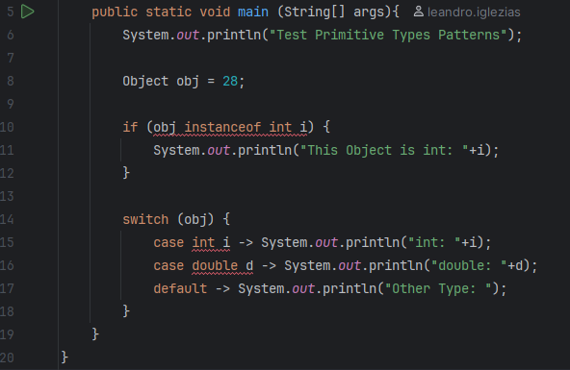
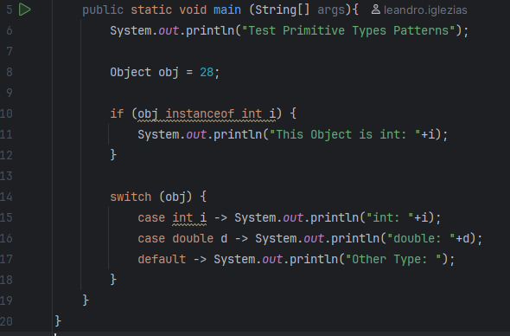
Java 25 new FEatures
Primitive Types in Patterns (JEP 507 – Preview)
We can now use primitive types switch-case
Java 21
Java 25
Notes:
So we can use primitive types in switch-case
Again in Java 21 we have compiler error without using a wrapper
And java 25 we can use in case clause

Slide 8
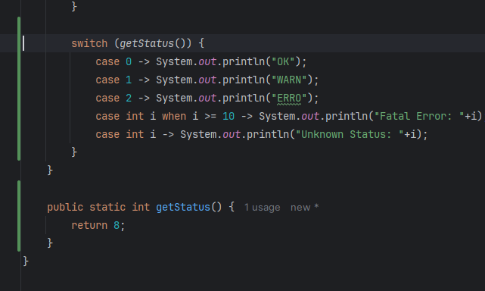
Java 25 new FEatures
Primitive Types in Patterns (JEP 507 – Preview)
Allow guards to inspect the matched value
We can replace the default clause using primitive to cover others cases
Java 25
Notes:
And better
In switch case, we use primitive type patterns to allow guards to inspect the matched value
We can replace default clause into a case clause with a primitive type pattern that exposes the matched value

Slide 9
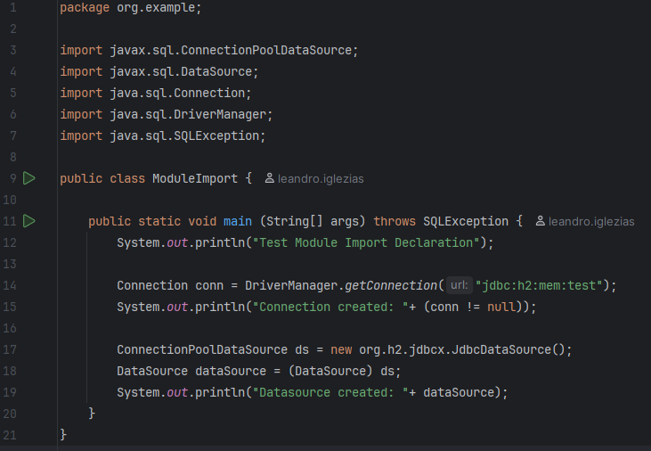
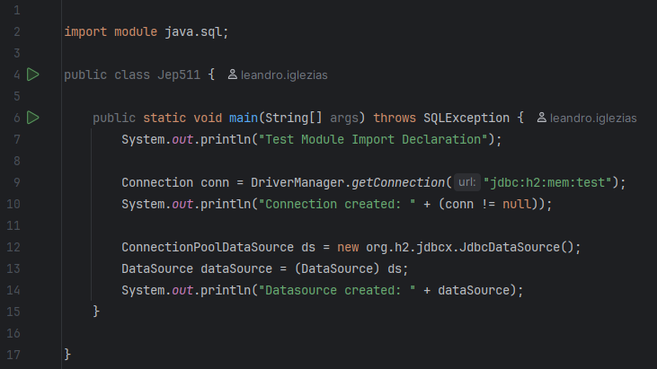
Java 25 new FEatures
Module Import (JEP 511)
Reduce number of import lines
Java 21
Java 25
Notes:
The next feature is Module Import.
It introduces a new import module syntax, allowing all public packages of a module to be imported with a single declaration.
This example in Java twenty on shows how many imports are need to do a simple connection with DataBase,
In java twenty five we just import module java.sql and all classes needed to do this connection are avaible.
Reduced Boilerplate: Significantly cleans up the top of Java source files by replacing multiple import statements with a single, concise import module declaration

Slide 10
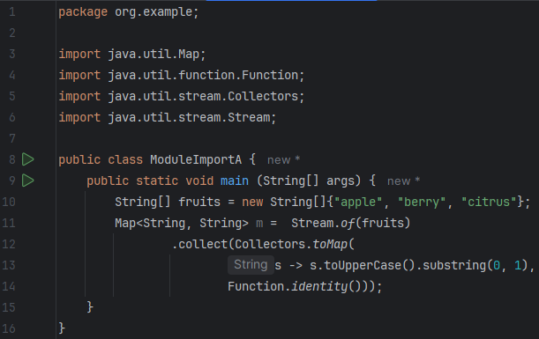
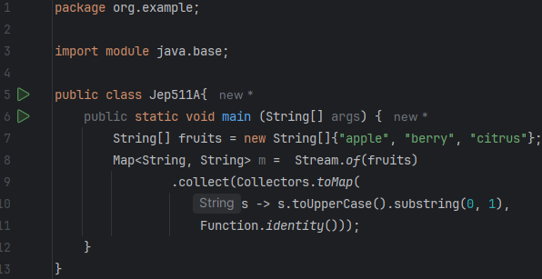
Java 25 new FEatures
Module Import (JEP 511)
Reduce number of import lines
Java 21
Java 25
Notes:
Another example in Java twenty on shows how many imports are need to do a simple converts an array of strings into a map from capital letters to strings, almost half of code is imports.
In java twenty five we just import module java.base and this useful structures are available.

Slide 11
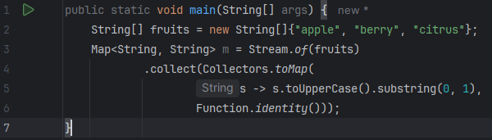
Java 25 new FEatures
Module Import (JEP 511)
Reduced Boilerplate
Improved Code Readability
Java 25
Notes:
And now classes and interfaces such as List, Map, Stream, and Path are automatically imported
So with this Jep we have
Reduced Boilerplate: Significantly cleans up the top of Java source files by replacing multiple import statements with a single, concise import module declaration
Improved Readability: A single import module statement clearly indicates the intent to use a broad range of functionalities provided by a specific module.

Slide 12
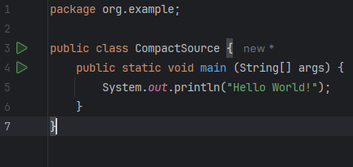
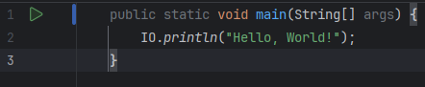
Java 25 new FEatures
Compact Source Files and Instance Main Methods (JEP 512)
Developers can omit package and module declarations
Can code methods and fields without explicitly declaring a surrounding class
A compact source file declares a class implicitly
Java 21
Java 25
Notes:
The next feature is Compact Sources Files and Instance Main Methods
This one reduces the boilerplate code required for simple Java programs.
We can omit the class declaration entirely.
The java compiler automatically generates an implicitly declared class named after the source file
All top-level methods and fields we write become members of this compiler-generated class. The compiler also automatically adds a default, zero-argument constructor.
Must have a main method, if it does not, a compile-time error is reported.
Also Compact source files automatically access all public classes and interfaces from the java.base module, like List, Map, LocalDate. without needing import statement.
In this example we have a new utility class java.lang.IO, which provides simpler console I/O methods like println and readln

Slide 13
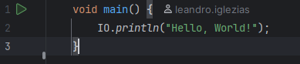
Java 25 new FEatures
Compact Source Files and Instance Main Methods (JEP 512)
Developers can omit package and module declarations
Can code methods and fields without explicitly declaring a surrounding class
A compact source file declares a class implicitly
Allow main to be non-static, and drop the requirements for public and an array parameter
Java 21
Java 25
Notes:
If compact source file, We eliminate the need to declare a class around the main method.
Now we will eliminate public static and String args
Java launcher now recognize simples non-static main methods: void main()
When the launcher finds an instance main method, it automatically creates an instance of the implicitly class and then calls the main method on that instance.
The method main does not need to be public and static
This changes allow the beginners to write simple programs immediately without learn concepts like access modifiers, static method and array parameters, this way the smooth on-ramp to Java programming

Slide 14
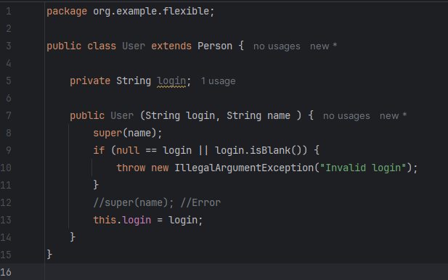
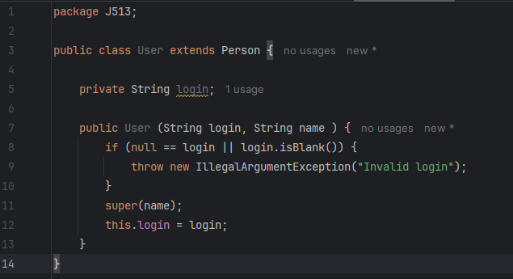
Java 25 new FEatures
Flexible Constructor (JEP 513)
Superclass constructors no longer need to be the first line of class constructor.
Fail-Fast Validation
Java 21
Java 25
Notes:
This JEP removes a long-standing, rigid restriction in Java constructors: the requirement that an explicit call to a superclass constructor (super(...)) or another constructor in the same class (this(...)) must be the very first statement in the constructor body.
You can now validate parameters, compute values, prepare data before the object initialization logic starts
Its good to validate input parameters immediately and throw an exception before the superclass constructor is ever called, saving resources and guaranteeing integrity
BUT

Slide 15
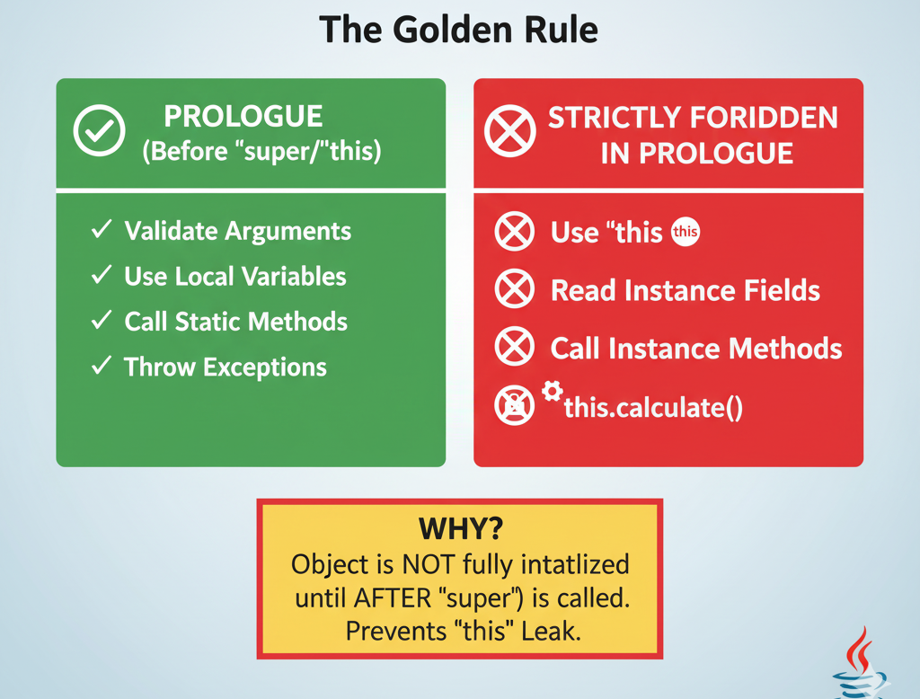
Java 25 new FEatures
Flexible Constructor (JEP 513)
The constructor is dived in 2 phases: Prologue and Epilogue
Prologue (code before this/super)
Epilogue (code after this/super)
The Golden Rule: Can’t use this, read fields, or call instance methods in the prologue
Notes:
But this is not a madhouse; we have some rules to follow.
To explain how it works, the constructor is divided into 2 phases: Prologue is the code before the explicit this or super, and the Epilogue is the code after the explicit this or super.
The golden rule is we can’t use this, read fields, or call instance methods in the prologue. And it is logical, the objects are not fully constructed at that point, so accessing instance-level data could lead to unpredictable behavior

Slide 16
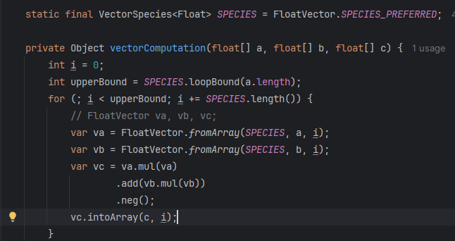
Java 25 new FEatures
Vector API (JEP 508 - Incubator)
API to express vector computations that reliably compile at runtime to optimal vector instructions on supported CPUs
Achieving performance superior to equivalent scalar computations
Java 25
Notes:
Vector API is in Tenth Incubator, your first release was in java 16 and the main goal here is to enable developers to write Java code that can leverage Single Instruction, Multiple Data (SIMD) found on modern CPUs.
This allows for parallel computations on multiple data elements with a single CPU instruction, significantly boosting performance for data-parallel workloads.
In this example we have a method receive 3 float arrays, do some calculate with array A , B and store in array C
We declare a VectorSpecies<Float> with the A preferred Species - maximal bit-size for the platform.
The var upperBound store the number of loops to interate the vector with this array size
This loop jump length Species, will be a size of vector for each interation
The next line we have a load chunk of data from input array A to vector VA.
It’s the same for Vector B
And Vector C is result of this expression
And the last line transform the Vector C in array C

Slide 17
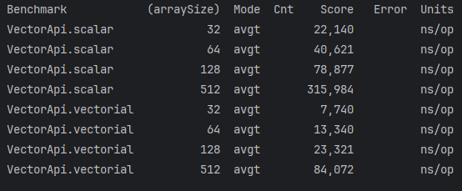
Java 25 new FEatures
Vector API (JEP 508 - Incubator)
API to express vector computations that reliably compile at runtime to optimal vector instructions on supported CPUs
Achieving performance superior to equivalent scalar computations
Java 25
Benchmark
Notes:
Here we have some results of Benchmark using Java Microbenchmark Harness, this code was executed for arrays size thrity two, sixty four, one hundred twenty eight and five hundred twelve.
We can see the vector computation have a better performance than scalar computation.

Slide 18
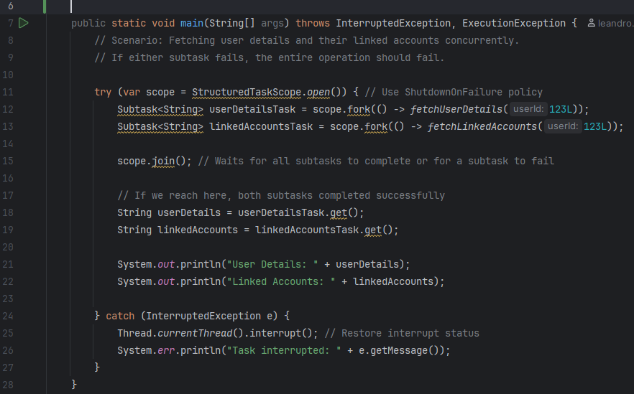
Java 25 new FEatures
Structured Concurrency (JEP 505 - preview)
Simplify concurrent programming
Groups of related tasks running in different threads as single units of workFlexibility as to the timing of their initialization
Java 25
Notes:
This feature introduces the StructuredTaskScope class, which provides a framework for managing a group of related concurrent tasks.
The core principle is that a "parent" task owns a StructuredTaskScope, and any "child" tasks forked within that scope are part of that group.
The join() method of the scope ensures that the parent task cannot complete until all its children have terminated.
The ShutdownOnFailure policy, for example, will automatically cancel any remaining child tasks if one fails, preventing resource leaks and simplifying error handling in complex asynchronous workflows.
In this code we have a fetching user details and their linked accounts concurrently, if either subtask fails, the entire task should fail.

Slide 19
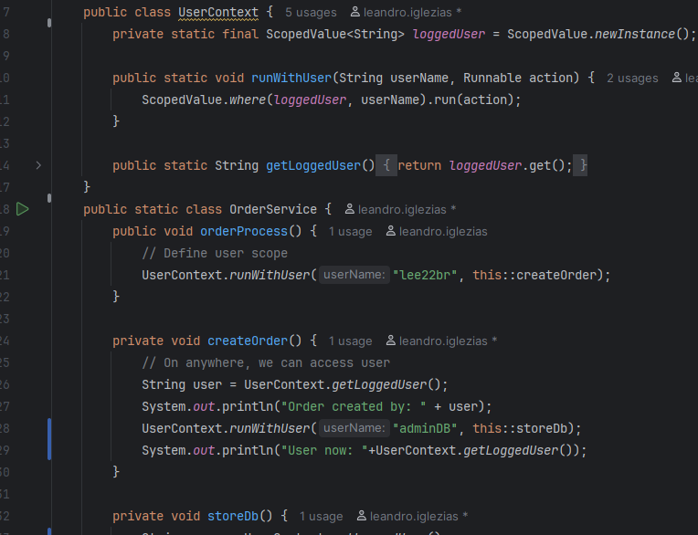
Java 25 new FEatures
Scoped Values (JEP 506)
More efficient way to share immutable data between threads
Java 25
Notes:
The nexte one is A ScopedValue
is an immutable carrier of data that is bound for a limited, well-defined duration. The value is only accessible to the code running within that block and any methods it calls.
It is typically declared as a static final field, and its accessibility is set to private so that it cannot be directly accessed by code in other classes.
In this code we created a scoped value logged User, defining a user to create an order, but when saving it to the database we used another user called adminDB with the scope only of that method storeDb

Slide 20
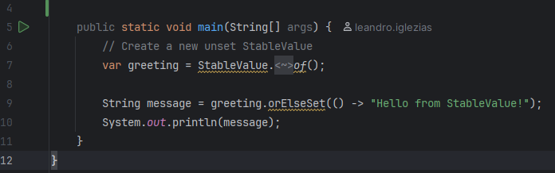
Java 25 new FEatures
Stable Values (JEP 502 - preview)
Kind variable that hold immutable data
Treated as constants by the JVM
Flexibility as to the timing of their initialization
Java 25
Notes:
Stable Values are objects that hold immutable data. Stable values are treated as constants by the JVM
Since an immutable object can be only in one state and therefore can be shared freely across multiple threads.
This a piece of code to how create a stable value

Slide 21
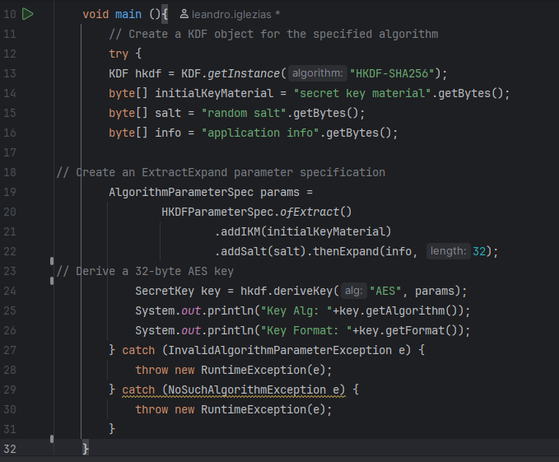
Java 25 new FEatures
Key Derivation Function API(JEP 510)
Provides a standard API (javax.crypto.KDF) for deriving Keys
Official support for KDFs (e.g. HKDF) directly in the JDK.
Unified usage instead of relying on external libraries or homegrown implementations
Java 25
Notes:
This JEP provides a dedicated, standard API for Key Derivation Functions.
We have support for KDFs directly in JDK
The developers don´t need to third-party libraries or workarounds

Slide 22

let's see some code

Slide 23

THANK YOU!
Have a good lunch

Slide 24
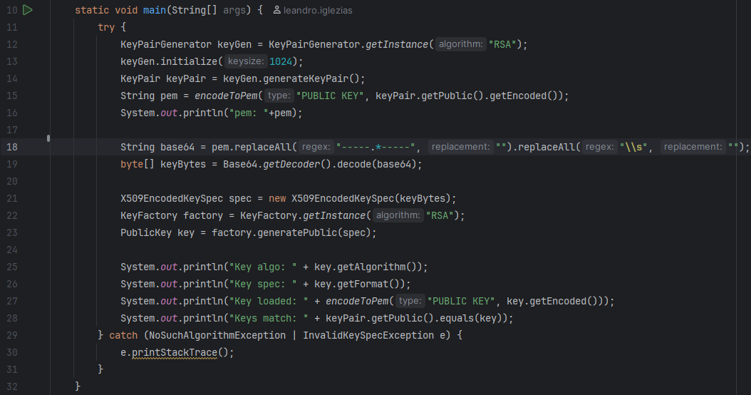
Java 25 new FEatures
PEM (Privacy-Enhanced Mail) Encoding (JEP 470 - preview)
API for encoding objects that represent cryptographic key
Simplify integration with authentication and security systems
Java 25

